Slide 1
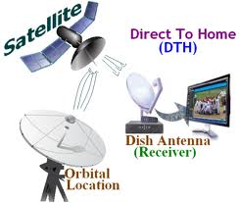
ISDB-S
The Integrated Services Digital Broadcasting -Satellite
Team:
Ahmed Sami 201700259
Mahmoud Yasser 201700960
Rahma Hassan 201501344

Slide 2
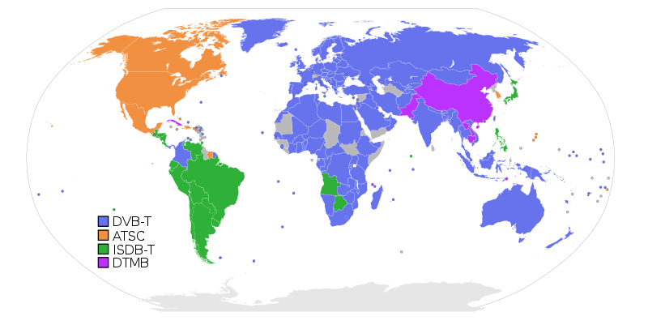
Global View: Digital television (DTV)
Digital Video Broadcasting (DVB)
Advanced Television System Committee (ATSC)
Integrated Services Digital Broadcasting (ISDB)
Digital Terrestrial Multimedia Broadcasting (DTMB)

Slide 3
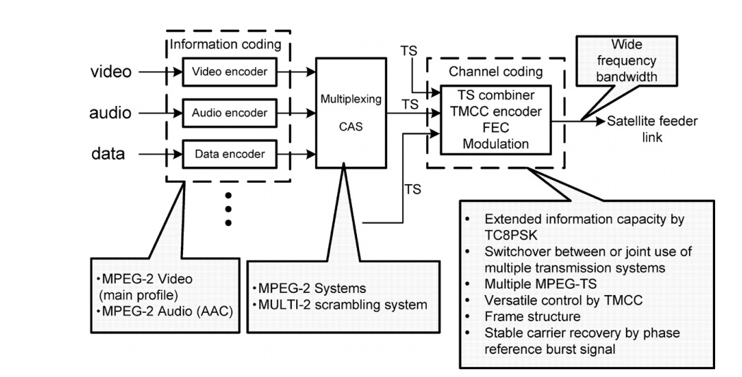
Introduction

Slide 4
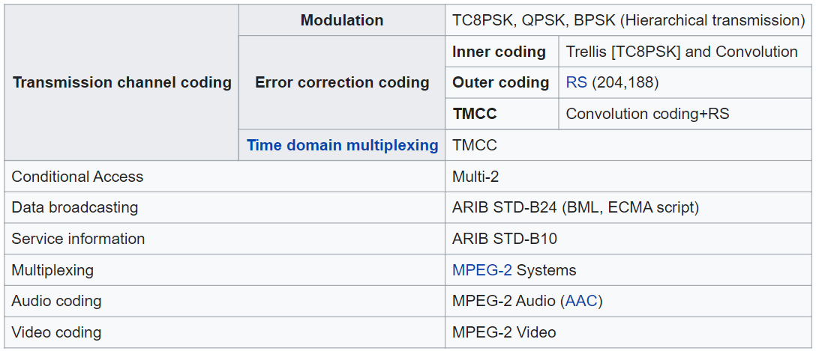
ISDB-S: Technical specification

Slide 5
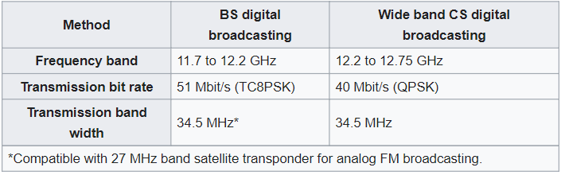
ISDB-S: Channel Specifications

Slide 6
MATLAB Simulation
For the MATLAB part we implemented:
Quantizer
Encoder
8PSK Modulator
Channel Effects
8PSK Demodulator
Decoder

Slide 7
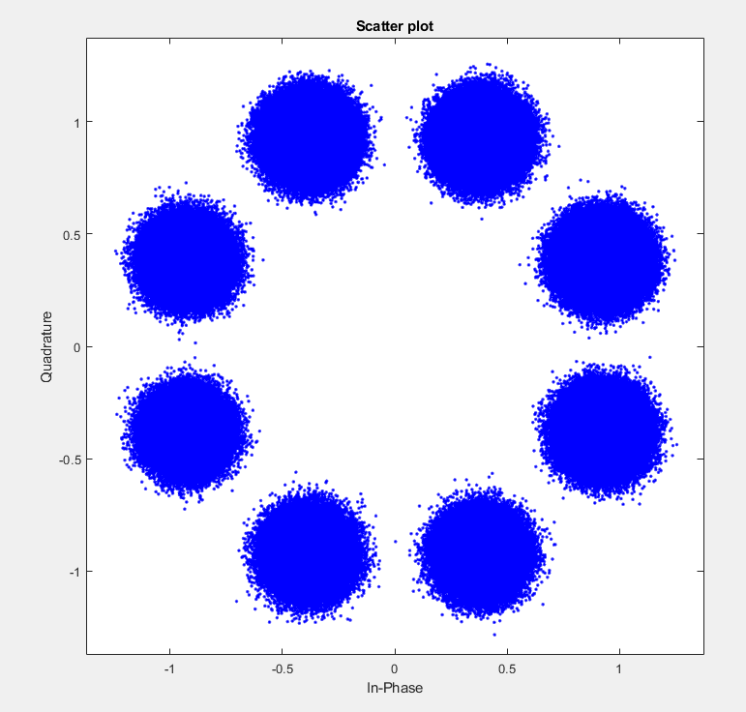
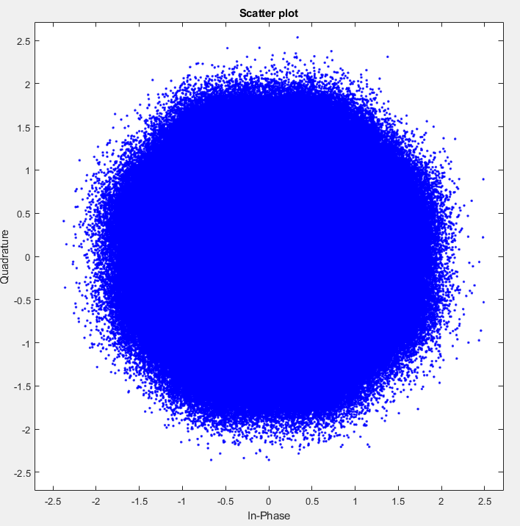
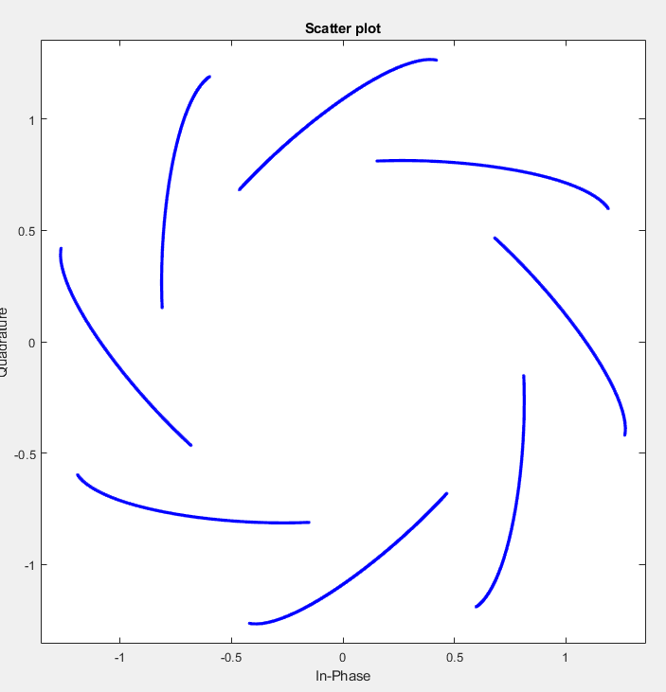
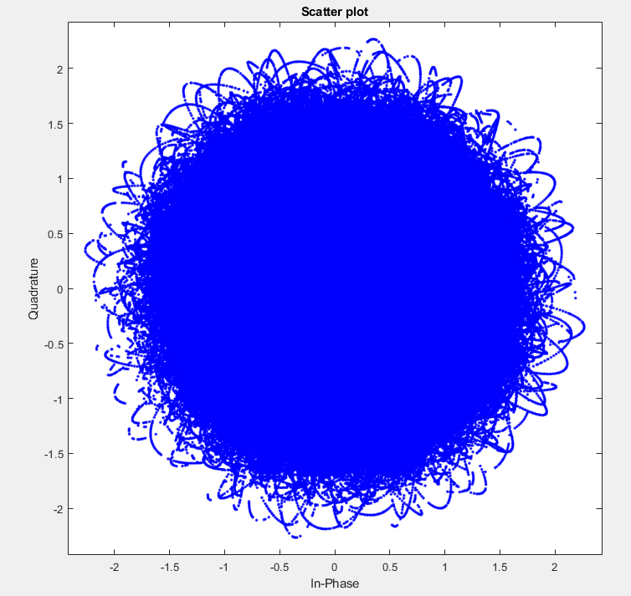
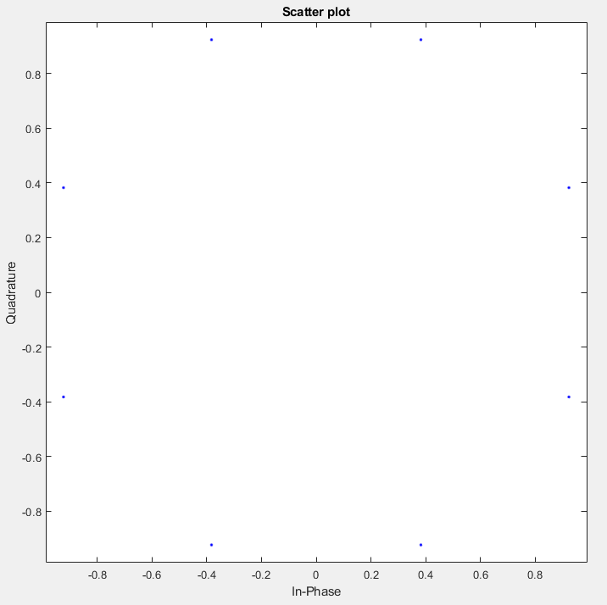
Results: Constellations
Original Image Constellation:
AWGN Channel Constellation: BER : 0.0996
Rayleigh Channel Constellation: BER: 0.5431
Rician Channel Constellation: BER: 0.1454

Slide 8
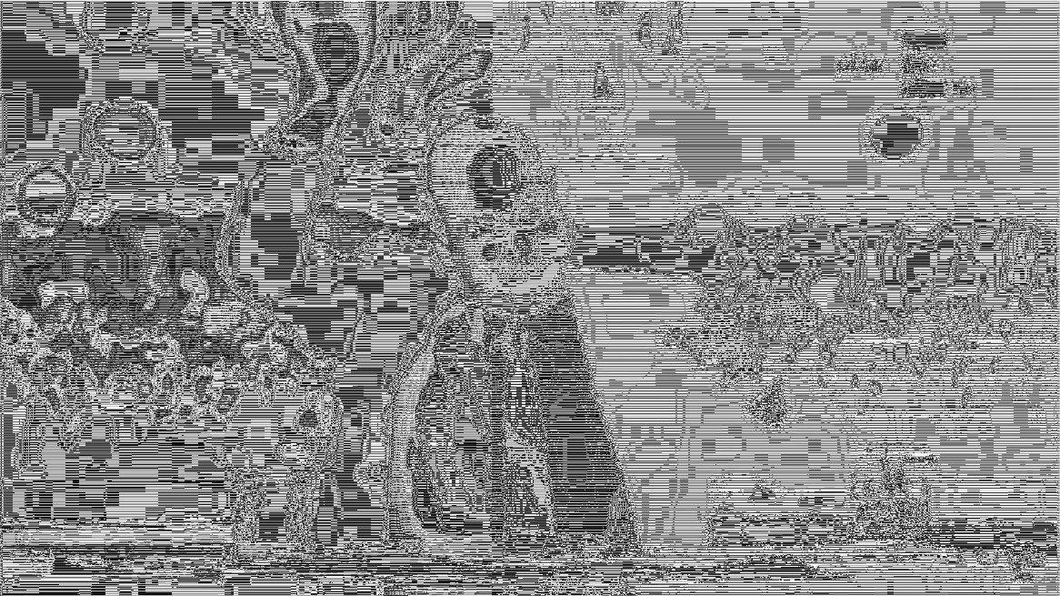
Rayleigh Channel: BER: 0.5431

Slide 9
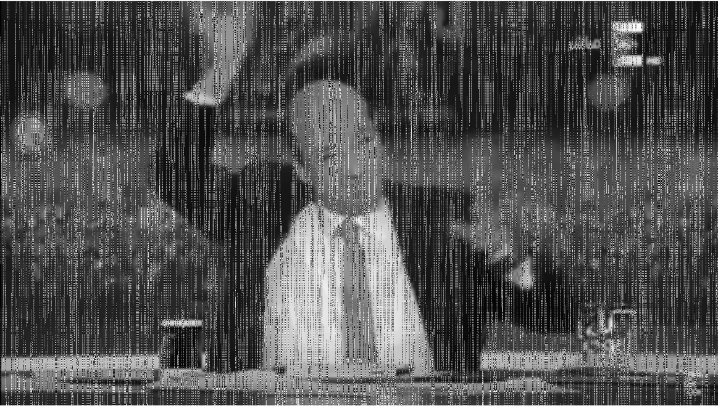
Rician Channel: BER: 0.1454

Slide 10
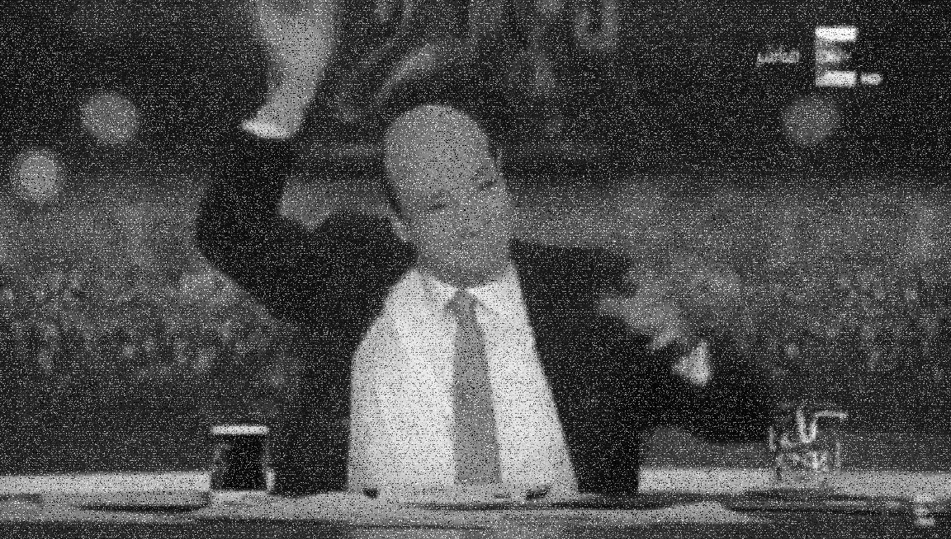
AWGN Channel: BER : 0.0996

Slide 11
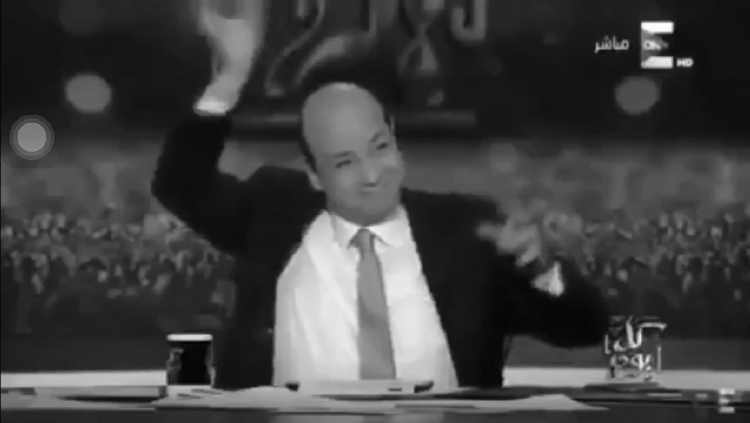
Original Image:

Slide 12

Audio
Rayleigh Channel: BER: 0.5
Rician Channel: BER: 0.1495
AWGN Channel: BER: 7.0833e-05

Slide 13

Original Video

Slide 14
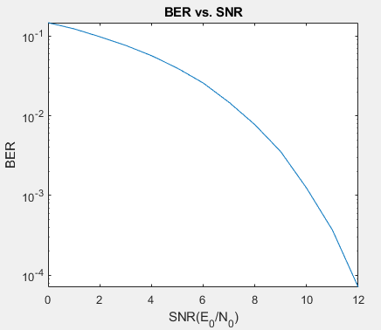
Audio: BER vs. SNR

Slide 15
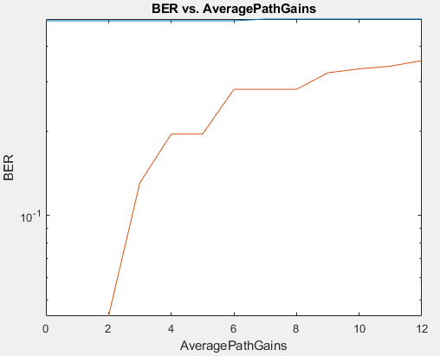
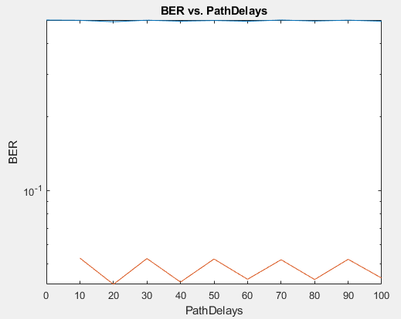
BER vs. Path Parameters (Red - Rician, Blue - Reliegh)

Slide 16
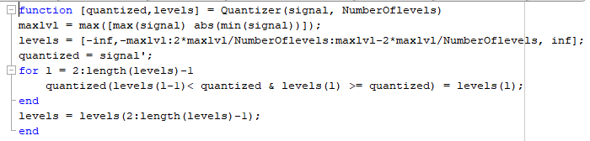
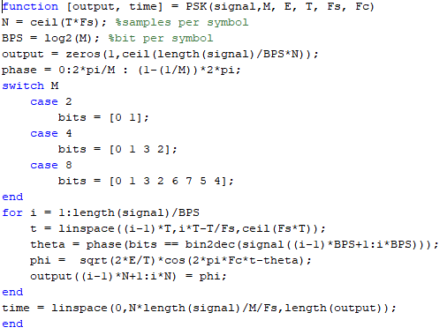
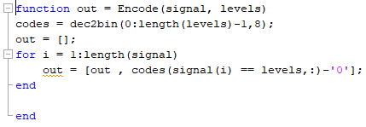
Code Snippets (Encoder-8PSK modulator-Quantizer)

Slide 17
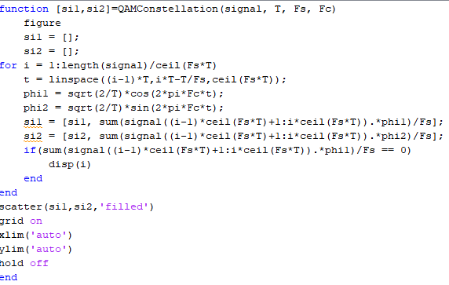
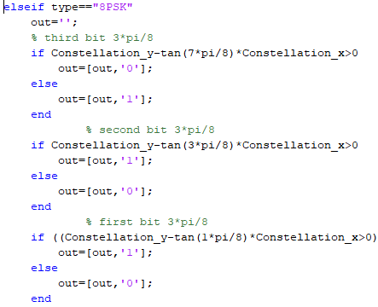
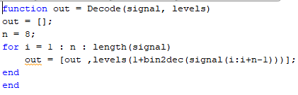
Code Snippets (decoder-8PSK ML receiver- Constellation Drawer)

Slide 18
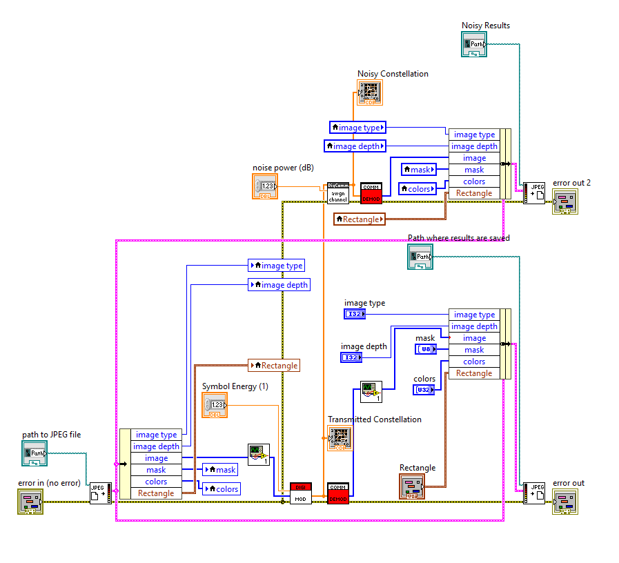
LabView

Slide 19
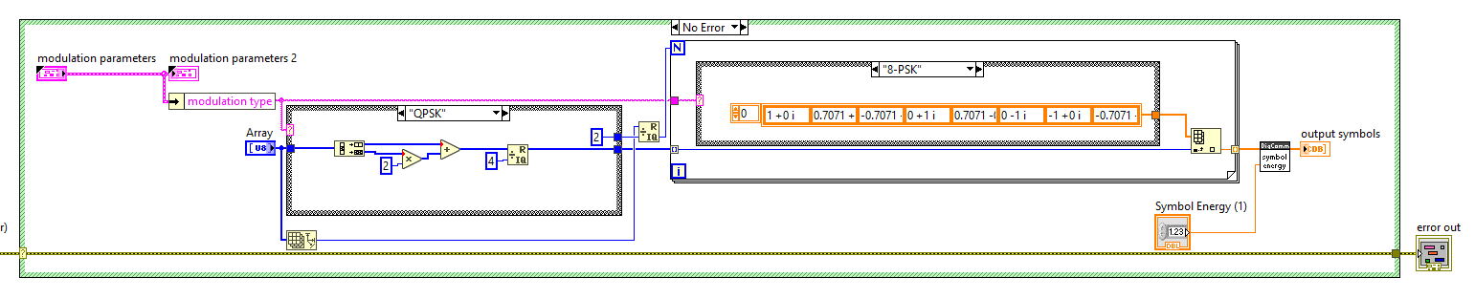
Modulation

Slide 20
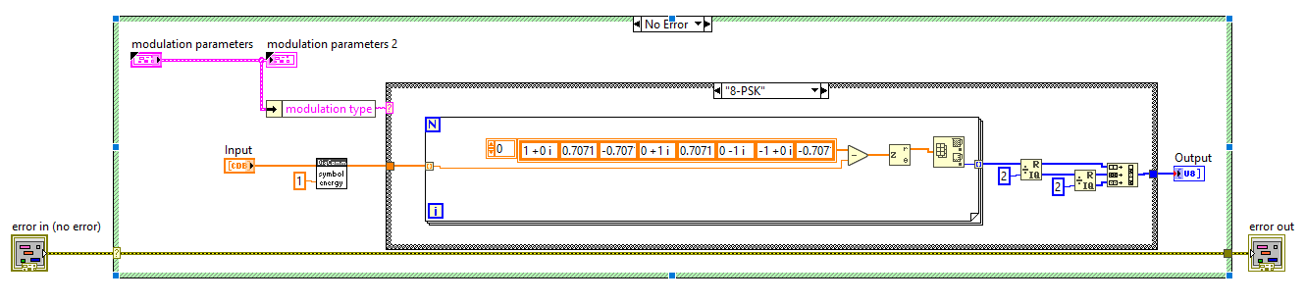
Demodulation

Slide 21
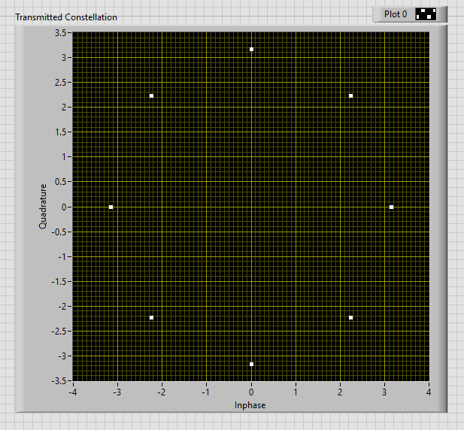
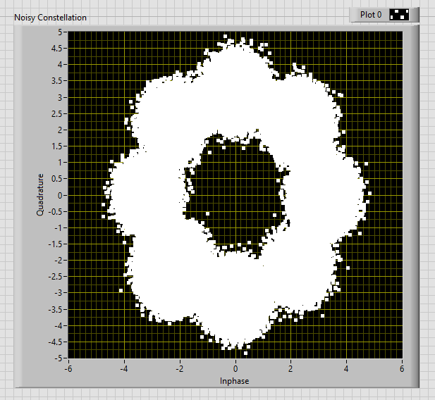
8-PSK
Symbol Energy = 10 Watt
Noise Energy = -5dBW

Slide 22
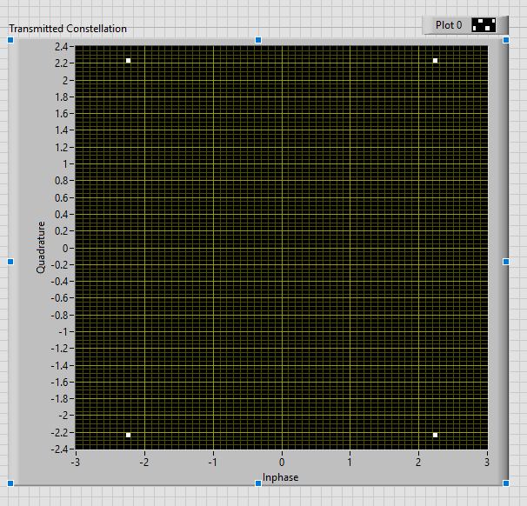
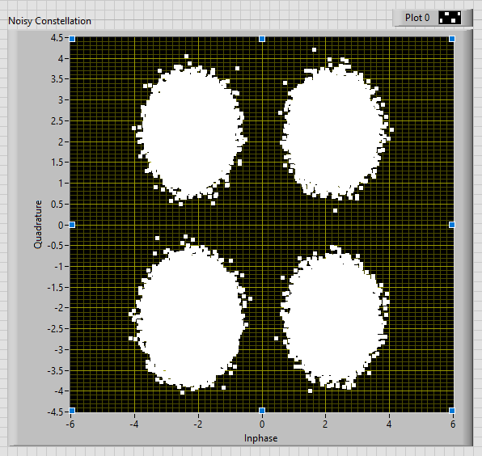
QPSK
Symbol Energy = 10 Watt
Noise Energy = -5dBW

Slide 23
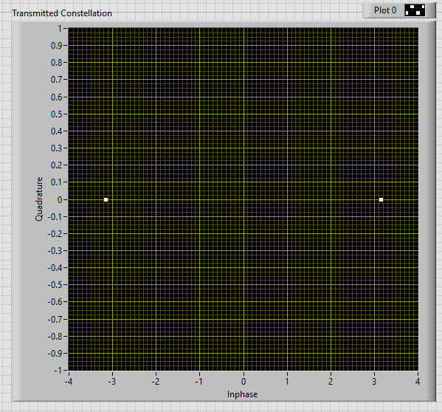
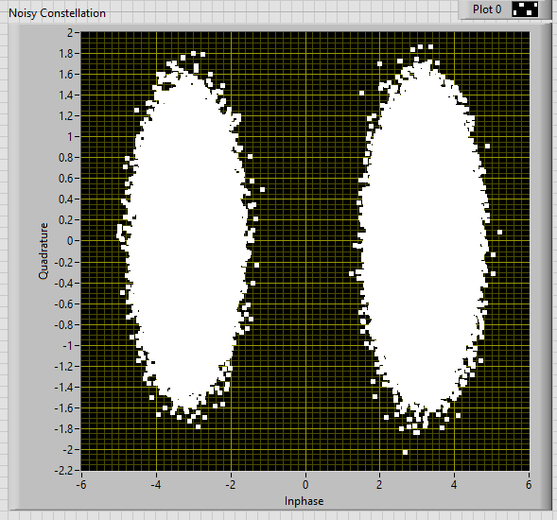
BPSK
Symbol Energy = 10 Watt
Noise Energy = -5dB

Slide 24


8-PSK

Slide 25

QPSK

Slide 26
BPSK

